Slide 1



Cover_Page
View in Power BI
Notes:
textbox
No alt text provided

Slide 2
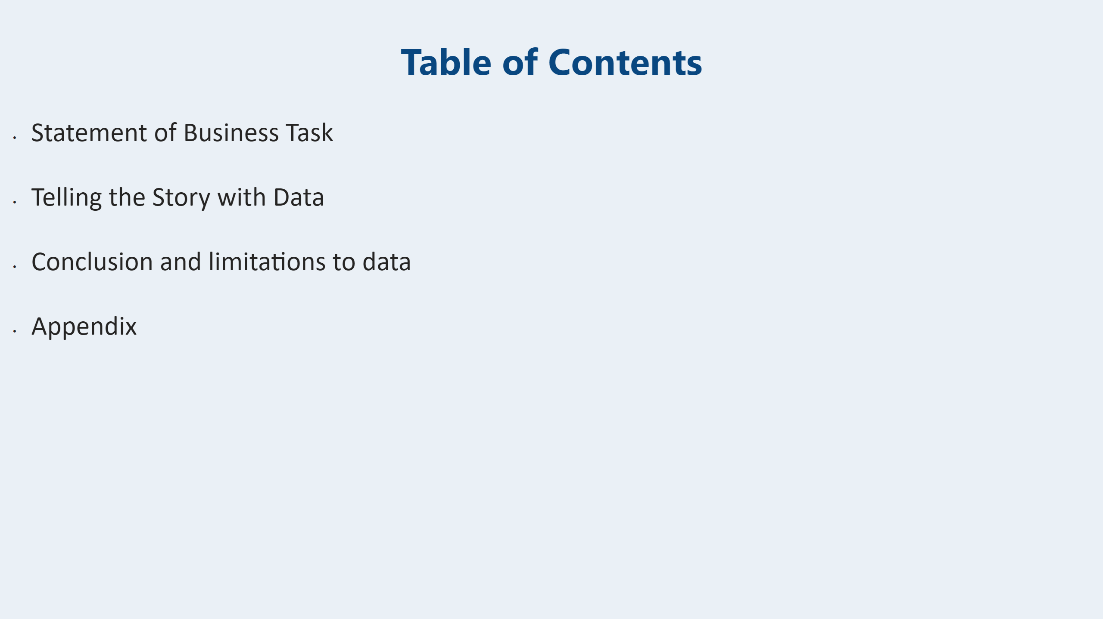
Table_of_Contents
Notes:
textbox
No alt text provided

Slide 3
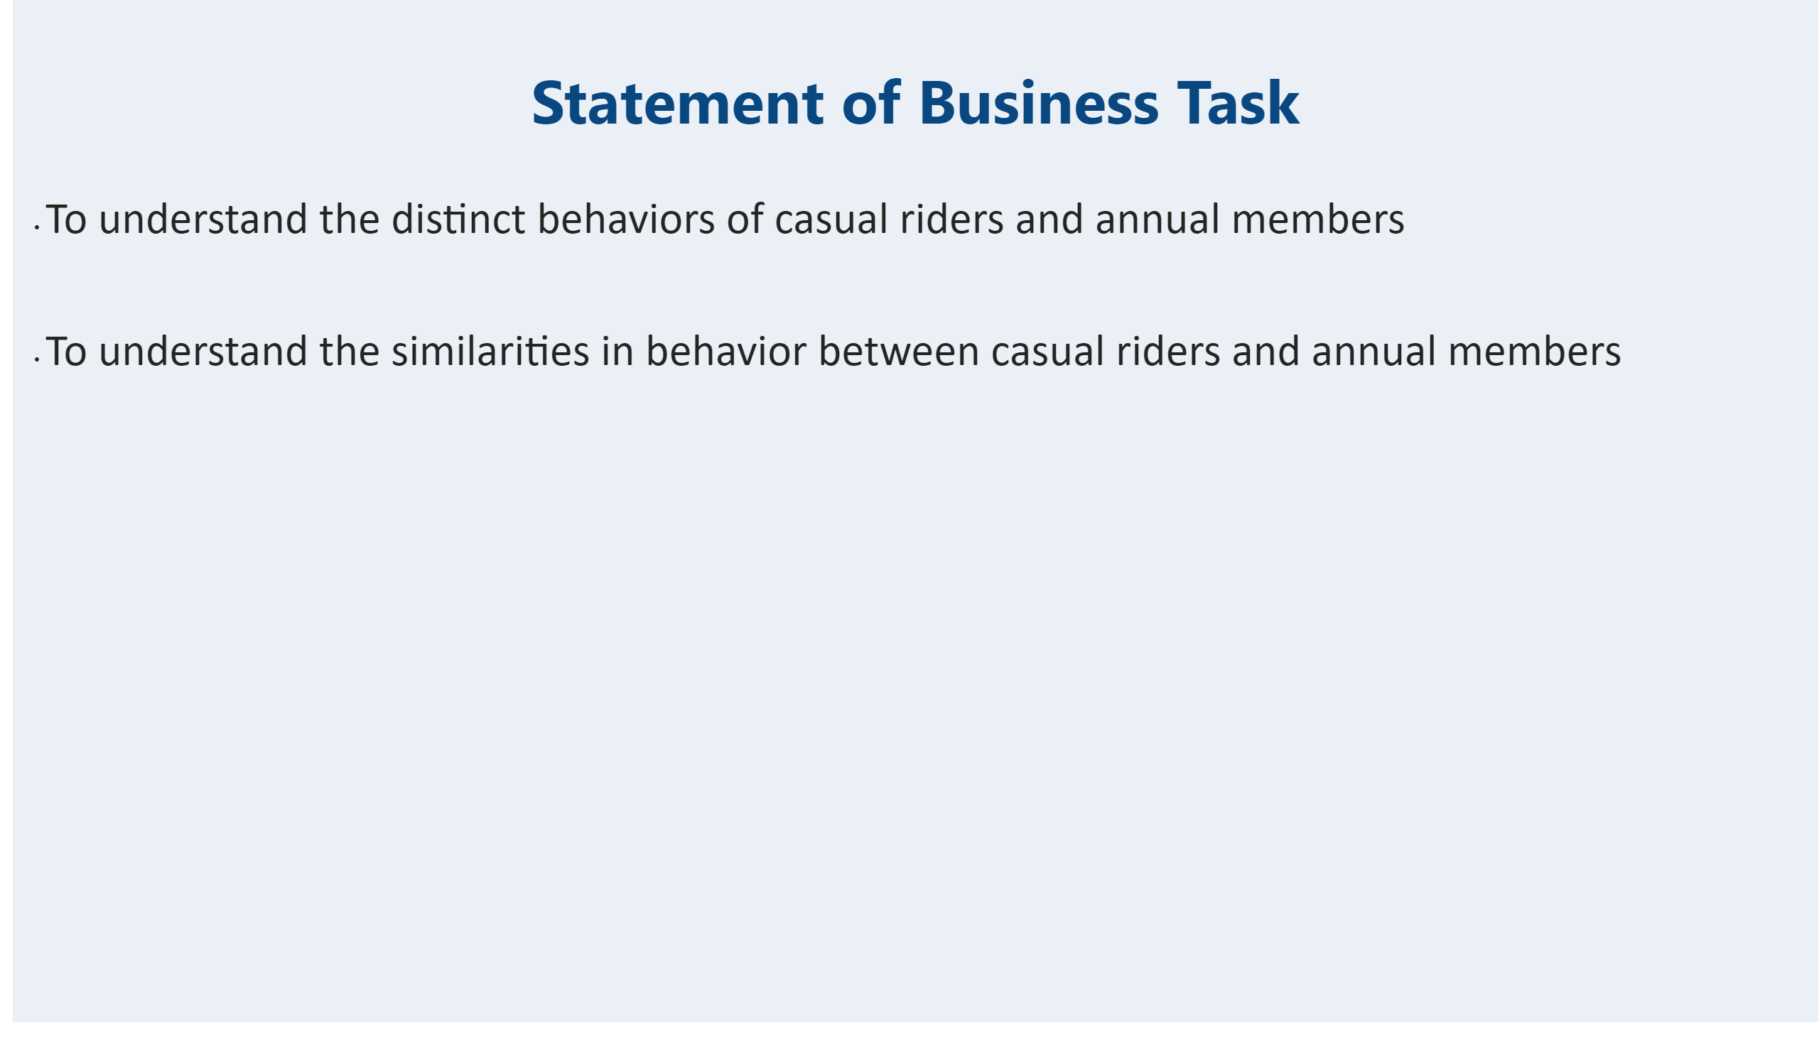
Statement-of-BusinessTask
Casual riders are riders who book a one-time or full day pass
Annual members are riders who pay for yearly subscription plans
Notes:
textbox
No alt text provided

Slide 4

.
Notes:
actionButton
No alt text provided

Slide 5
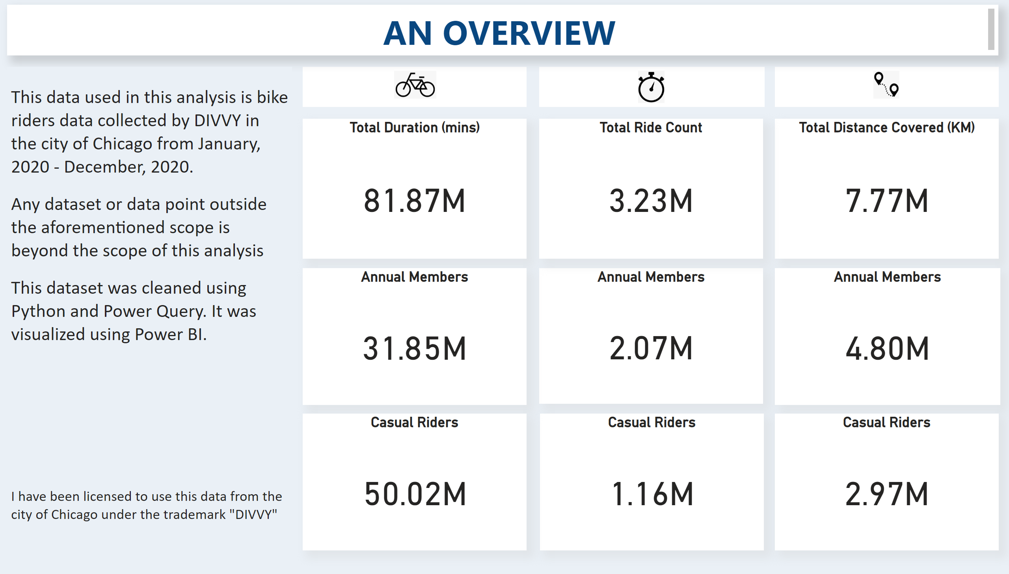
Overview
Notes:
Total Duration (mins)
No alt text provided
Annual Members
No alt text provided
Total Distance Covered (KM)
No alt text provided
Casual Riders
No alt text provided
Total Ride Count
No alt text provided
Annual Members
No alt text provided
Casual Riders
No alt text provided
Annual Members
No alt text provided
Casual Riders
No alt text provided
image
No alt text provided
image
No alt text provided
image
No alt text provided
textbox
No alt text provided
shape
No alt text provided
shape
No alt text provided
shape
No alt text provided
textbox
No alt text provided

Slide 6
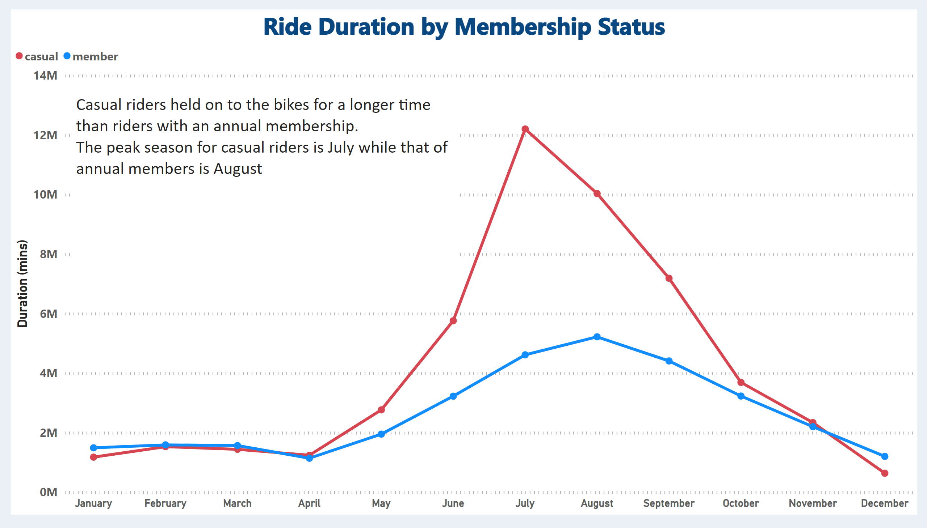
RideDuration_by_Month
Notes:
Ride Duration by Membership Status
No alt text provided
textbox
No alt text provided

Slide 7
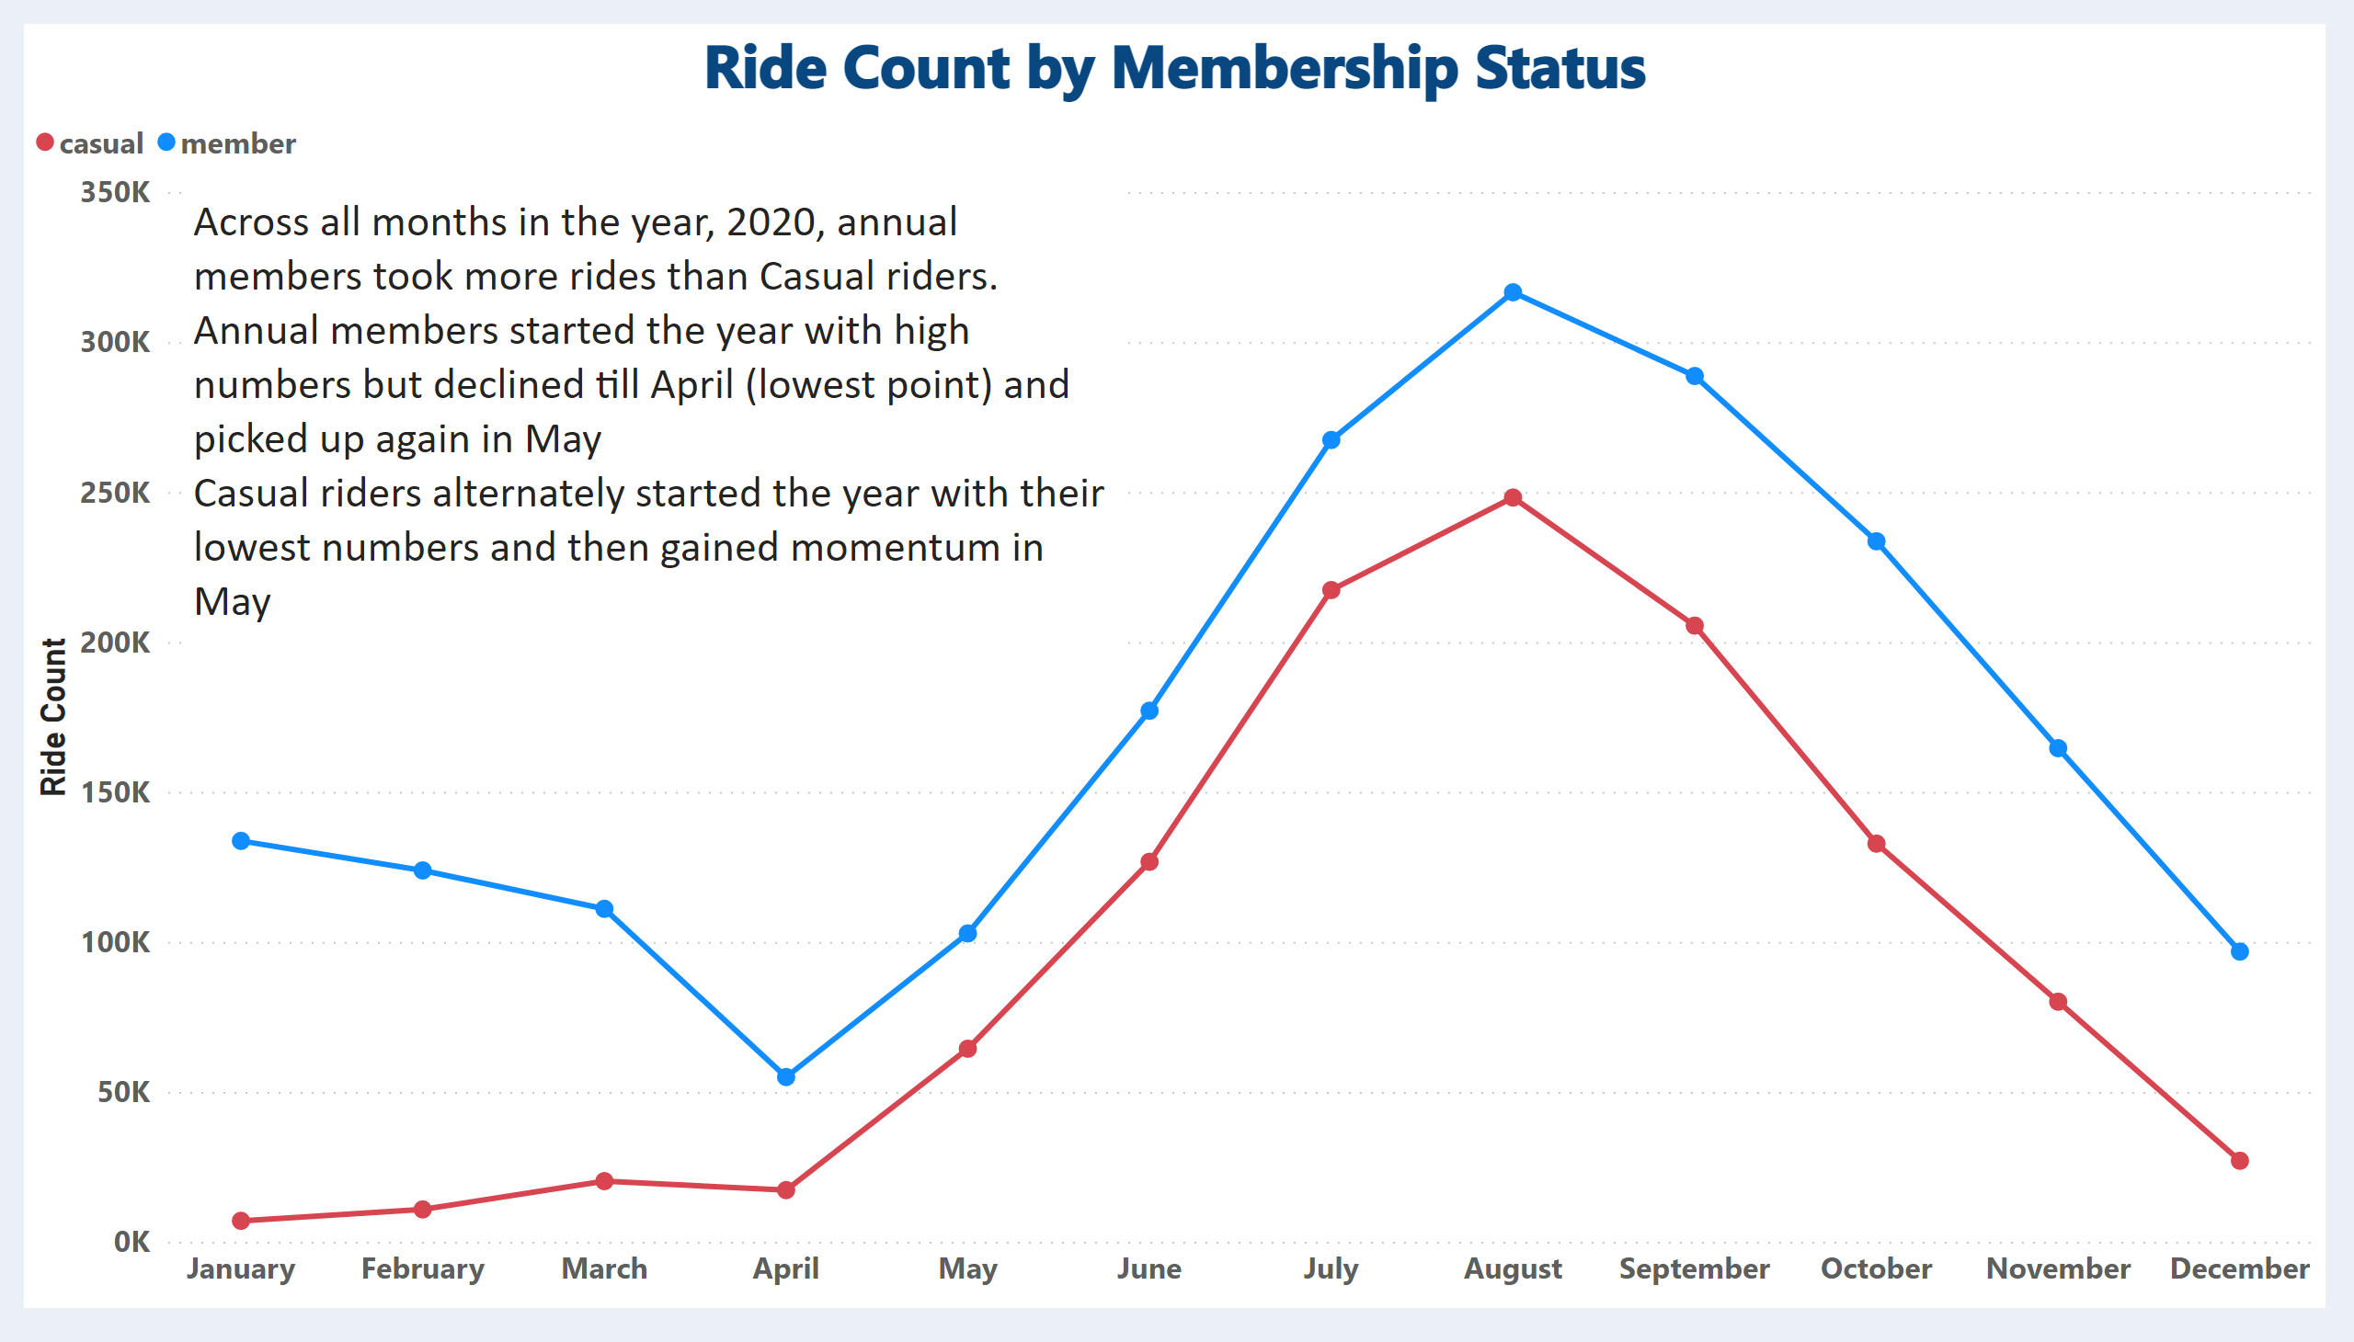
RideCount_by_Month
Notes:
Ride Count by Membership Status
No alt text provided
textbox
No alt text provided

Slide 8
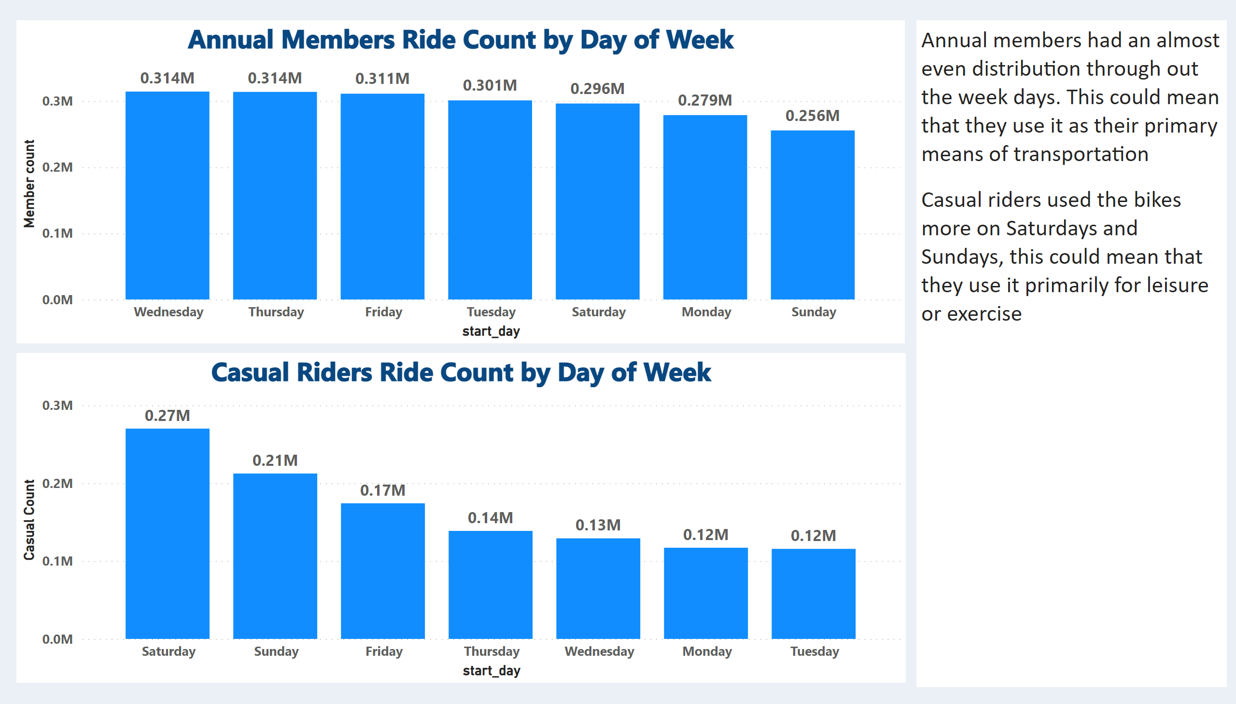
RideCount_by_Dayofweek
Notes:
Casual Riders Ride Count by Day of Week
No alt text provided
Annual Members Ride Count by Day of Week
No alt text provided
textbox
No alt text provided

Slide 9
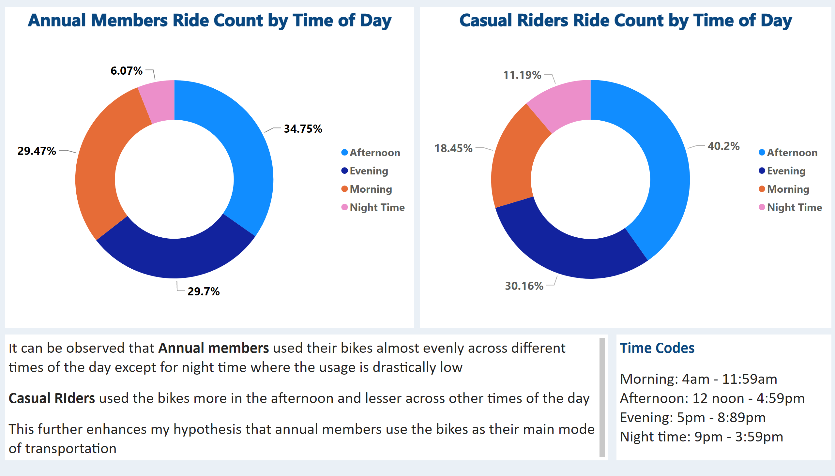
RideCount_by_TimeofDay
Notes:
Casual Riders Ride Count by Time of Day
No alt text provided
Annual Members Ride Count by Time of Day
No alt text provided
textbox
No alt text provided
textbox
No alt text provided

Slide 10
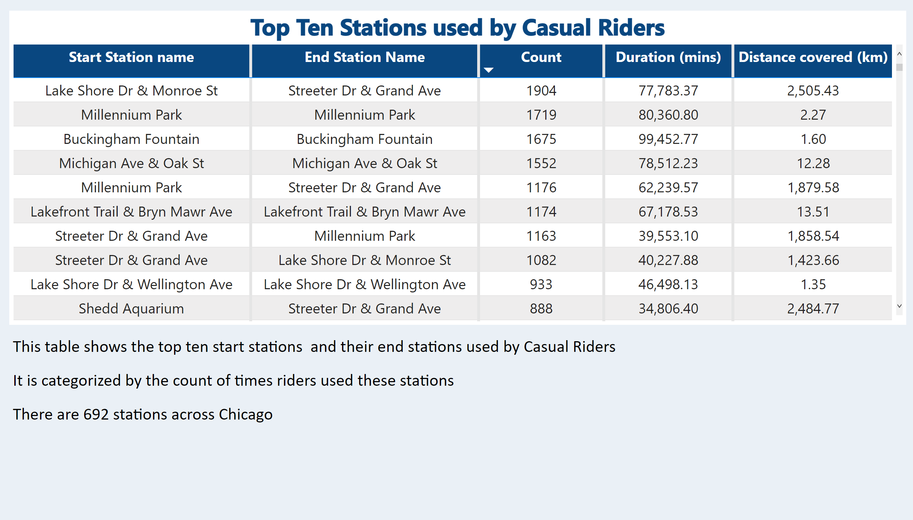
CasualRiders_stations_used
Notes:
Top Ten Stations used by Casual Riders
No alt text provided
textbox
No alt text provided

Slide 11
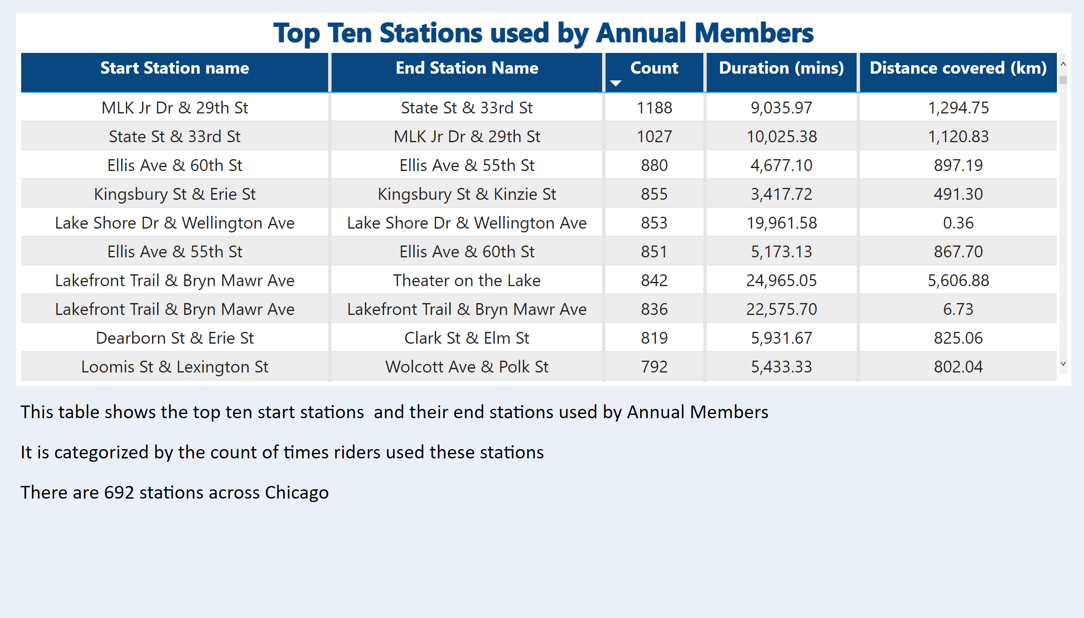
AnnualMembers_stations_used
Notes:
Top Ten Stations used by Annual Members
No alt text provided
textbox
No alt text provided

Slide 12
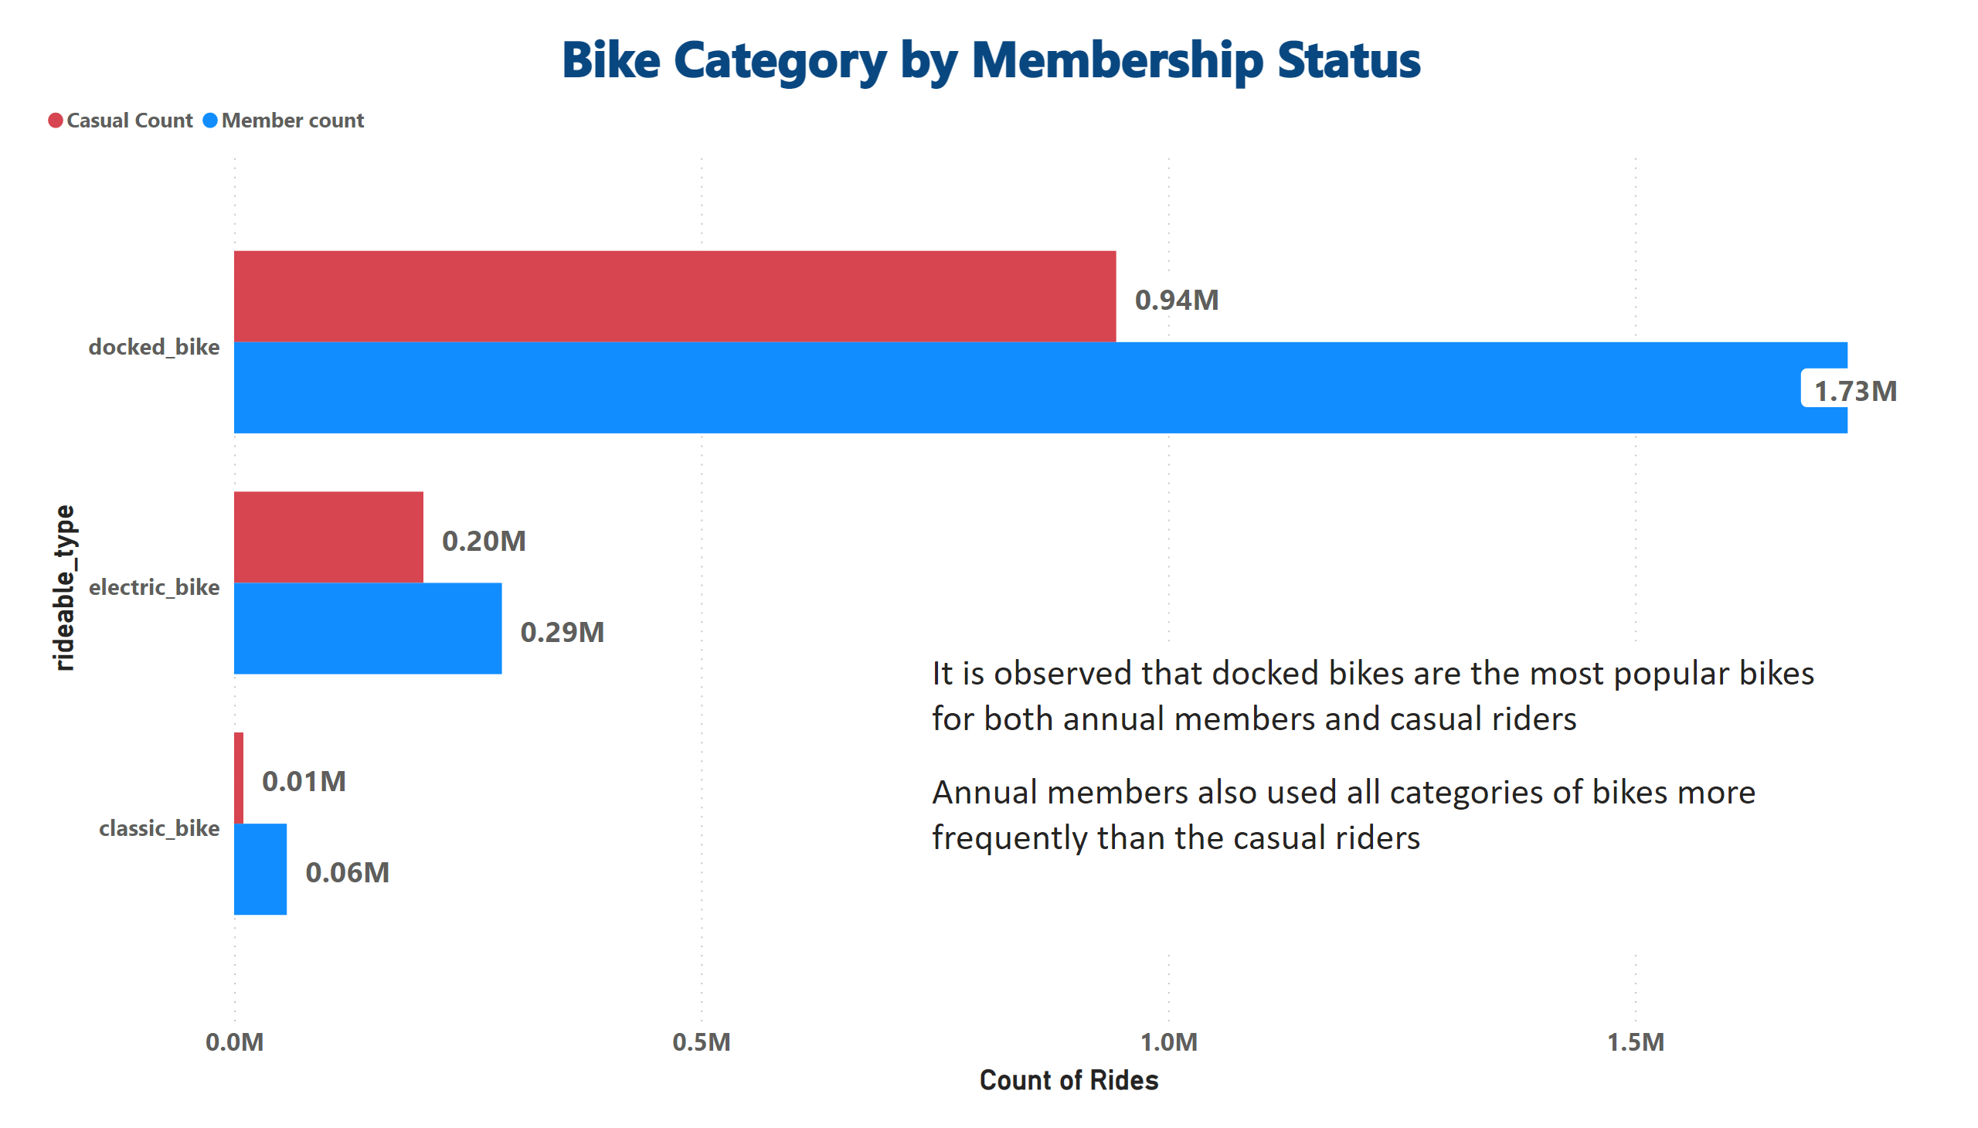
Bike_category
Notes:
Bike Category by Membership Status
No alt text provided
textbox
No alt text provided

Slide 13

.
Notes:
actionButton
No alt text provided

Slide 14
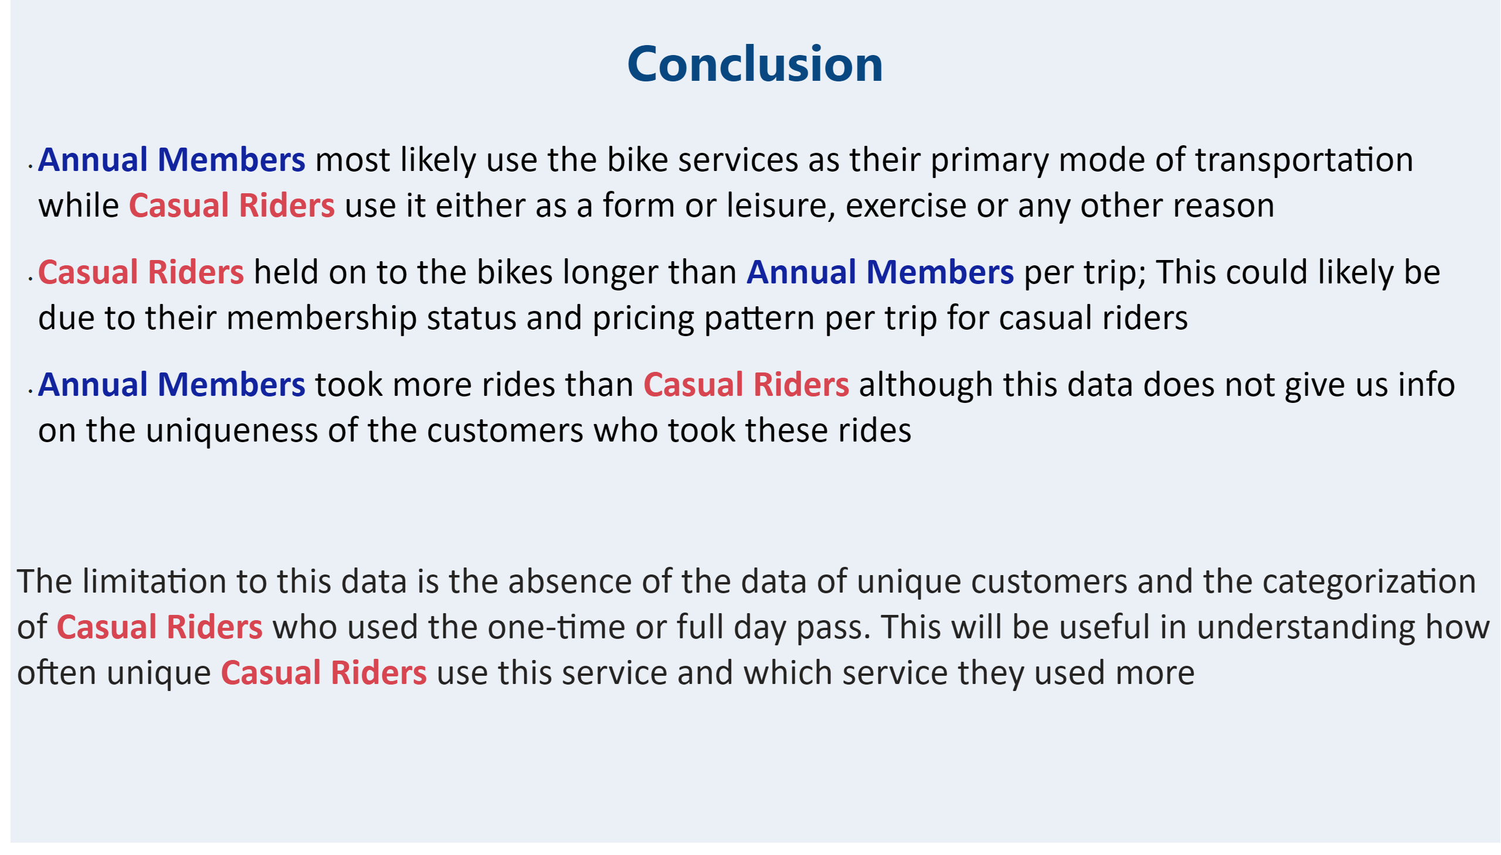
Conclusion
Notes:
textbox
No alt text provided

Slide 15

ThankYou
Notes:
actionButton
No alt text provided

Slide 16

Appendix
Notes:
actionButton
No alt text provided

Slide 17
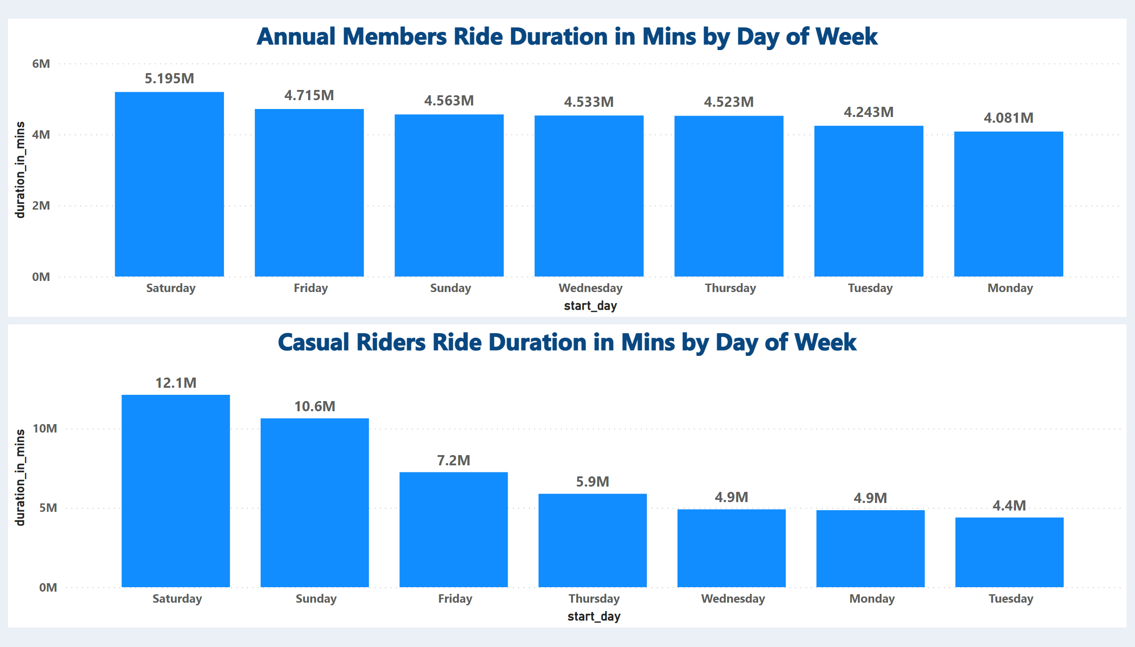
RideDuration_by_Dayofweek
Notes:
Casual Riders Ride Duration in Mins by Day of Week
No alt text provided
Annual Members Ride Duration in Mins by Day of Week
No alt text provided

Slide 18
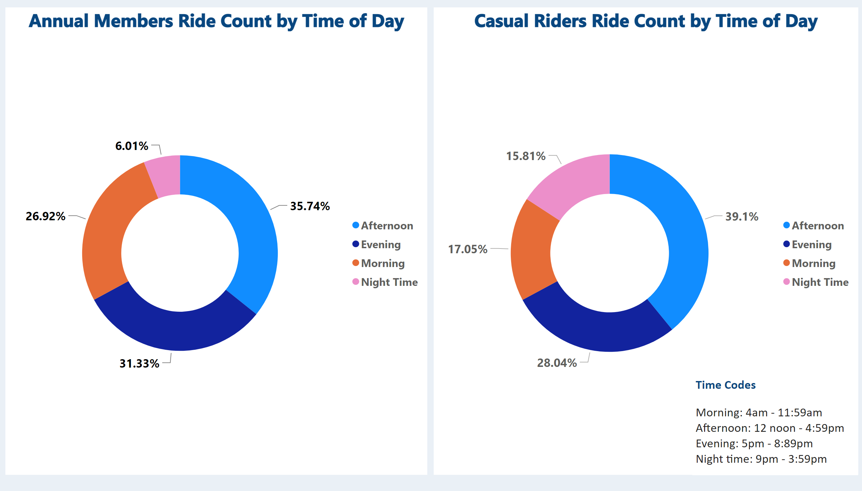
RideDuration_by_TimeofDay
Notes:
Casual Riders Ride Count by Time of Day
No alt text provided
Annual Members Ride Count by Time of Day
No alt text provided
textbox
No alt text provided

